Slide 1
Finite State Machine
-A final project-
Computer Systems, Fall 2020
https://github.com/EstherWerblowsky/FSM-in-C

Slide 2
What I Learned From This Project:

Slide 3
-C!!

Slide 4
-testing!!!!

Slide 5
-The hardest part?

Slide 6
MY CODE:

Slide 7
int main(int argc, char *argv[]) {
//testing code, if fails testing suite, exit program without continuing to I/O
testGetNextState();
testPrintState();
// make sure that exactly two file inputs are called with this program
//otherwise print an error message and exit gracefully
if (argc !=3) {
printf("Two command line arguments are required \n");
return -1;
}
printf("processing FSM definition file %s \n", argv[1]);
FILE *mapper;
mapper = fopen(argv[1], "r"); // open the mapping file
FILE *input;
input = fopen(argv[2], "r"); //open the input file
//check to make sure that they were opened properly if not, then print an error message and exit gracefully
if (mapper == NULL || input == NULL) {
printf("Not valid files passed \n");
return -1;
}

Slide 8
//initialize the arrays that are used as the DS for the FSM
int StateArr[ARRAY_LEN], NextStateArr[ARRAY_LEN];
char InputArr[ARRAY_LEN];
//garbage values to be used in the FSM
char garbage, garbageMore;
//counter to keep track of how many transitions there areand how long the storage arrays will be
int line_no = 0;
//variable to check how many values get scanned in
int scanResult;
//read in the values from the fsm file and store them in their respective arrays
while((scanResult = fscanf(mapper, "%d%c%c%c%d", &StateArr[line_no], &garbage, &InputArr[line_no], &garbageMore, &NextStateArr[line_no]))!= EOF && line_no< ARRAY_LEN){
//make sure that the file format is correct at each line
//otherwise print an error message and return
if(scanResult<5){
printf("incorrect format for input to FSM file");
return -1;
}
//check to make sure that no negative integers were in the FSM mapper
if (StateArr[line_no]<0 || NextStateArr[line_no]<0){
printf("Only positive states allowed in the FSM");
return -1;
line_no++;
}
}

Slide 9
printf("The FSM has %d transitions \n", line_no+1);
//a variable which keeps track of the input for each line of input in the file
char inputChar;
//counter which counts how many steps there are in the FSM
int in_line = 0;
//variable used to store the current and next states
int state = 0;
int nextState = 0;
while((scanResult = fscanf(input, "%c%c", &inputChar, &garbage))!=EOF && in_line<250){
//if the input is blank-print error statement and return
if (scanResult <1){
printf("Invalid input to FSM");
return -1;
}
//get the next state, and print the current step
nextState = printState(in_line, state, inputChar, line_no, StateArr, InputArr, NextStateArr);
//if the return is -1- there was an invalid input somewhere so return from program
if (nextState == -1){
printf("Not valid input to the FSM\n");
return -1;
}

Slide 10
printf("at step %d, input %c transitions the FSM from state %d to state %d \n", in_line, inputChar, state, nextState);
state = nextState;
in_line ++;
}
printf("after %d steps, state machine finished successfully at state %d\n", in_line, state);
fclose(mapper);
fclose(input);
} //END OF MAIN
//function called by the printState() method to search for the next state with given input and current state
int getNextState(int length, int state, char input, int StateArr[], char InputArr[], int NextStateArr[]){
//loop through the length of the filled DS of the FSM
for (int i = 0; i<= length; i++){
//search for the corresponding input and state
if (StateArr[i]== state && InputArr[i]== input){
//if found, return the appropriate next State
return NextStateArr[i];
}
}
//otherwise, there is no valid state in the FSM for that input and state combo so return -1
return -1;
}

Slide 11
//printState function- accepts current state, step in FSM, the current input, length of filled FSM arrays, and the FSM arrays
int printState(int step, int state, char input, int length, int StateArr[], char InputArr[], int NextStateArr[]) {
int nextState;
//check to make sure that the input is only a lowercase or uppercase letter
if (input > 'Z' && input <'a' || input > 'z' || input <'A') {
return -1;
}
//get the next state
nextState = getNextState(length, state, input, StateArr, InputArr, NextStateArr);
if (nextState == -1)
return -1;
return nextState;
}

Slide 12
TESTING:

Slide 13
//this function tests my getNextState function
void testGetNextState(void){
//initialization of testing arrays
int fState[25] = {0,2,3,4,5,6,7,8,9,10,22,34,56,78};
char fInput[25] = {'a','b','c','b','b','d','e','f','f','g','a','b','c','l'};
int fNext[25]= {3,4,5,7,23,1,23,43,54,65,5443,543,1213,43521};
//check that it works for a valid input
int result = getNextState(14,4, 'b', fState, fInput, fNext);
assert(result == 7);
//check that it returns the right thing with an invalid input
result = getNextState(14, 3, 'd', fState, fInput, fNext);
assert(result == -1);
//check another valid input
result = getNextState(14, 34, 'b', fState, fInput, fNext);
assert(result == 543);
}

Slide 14
//This function tests my printState() function
void testPrintState(void){
//initialization of arrays used for testing
int fState[25] = {0,2,3,4,5,6,7,8,9,10,22,34,56,78};
char fInput[25] = {'a','b','c','b','b','d','e','f','f','g','a','b','c','l'};
int fNext[25]= {3,4,5,7,23,1,23,43,54,65,5443,543,1213,43521};
//check that it returns a -1 in the case where the input does nothing for the FSM
int result = printState(3, 3, 'a', 14, fState, fInput, fNext);
assert(result == -1);
//check that it works when it is supposed to work
result = printState(3, 0, 'a', 14, fState, fInput, fNext);
assert(result == 3);
result = printState(3, 78, 'l', 14, fState, fInput, fNext);
assert(result == 43521);
//check that it registers when a non valid input is put in
result = printState(3, 78, '^', 14, fState, fInput, fNext);
assert(result == -1);
}

Slide 15
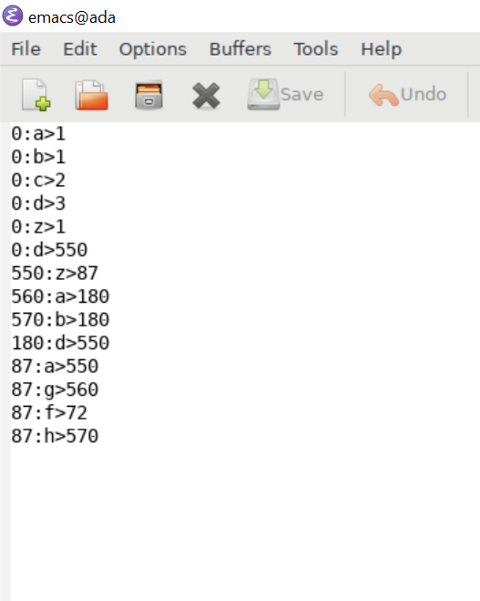
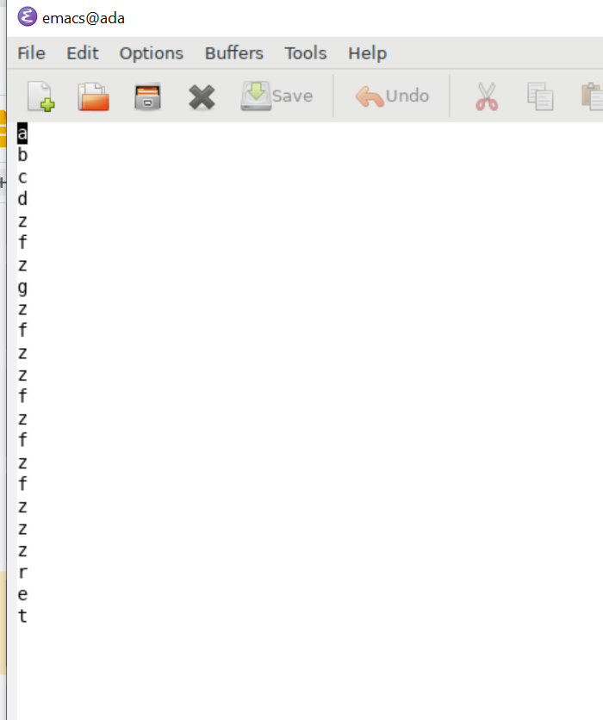
TEST 1: INVALID INPUT AT CURRENT STATE

Slide 16
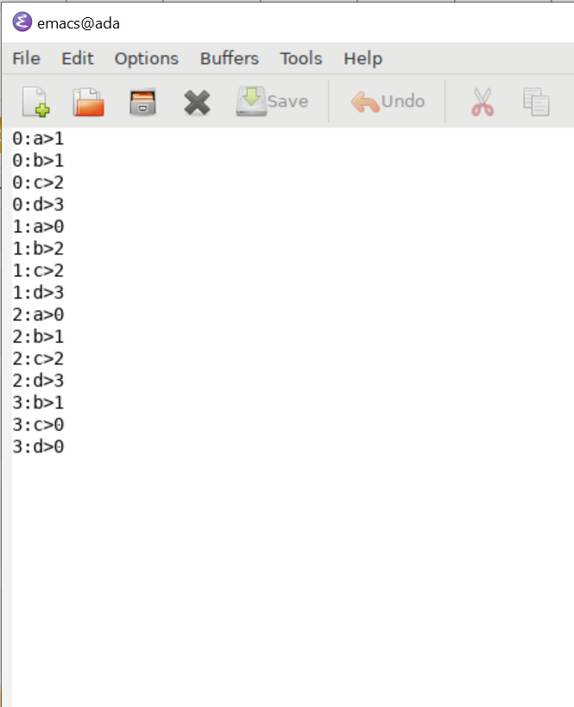

TEST 2: SUCCESSFUL COMPLETION

Slide 17

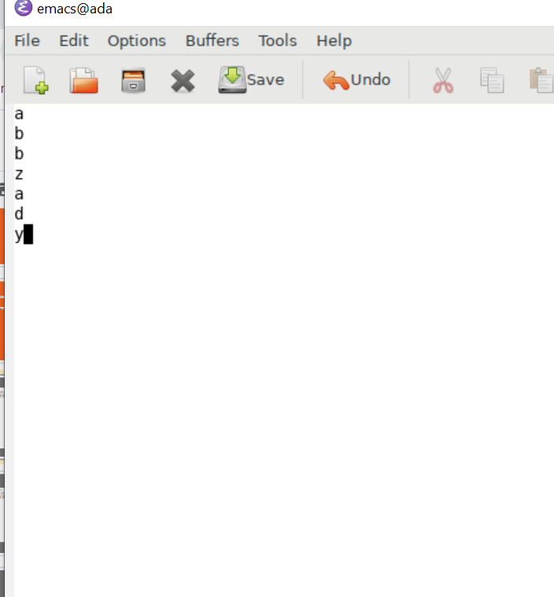
TEST 3: INVALID FSM FORMAT

Slide 18


